Slide 1
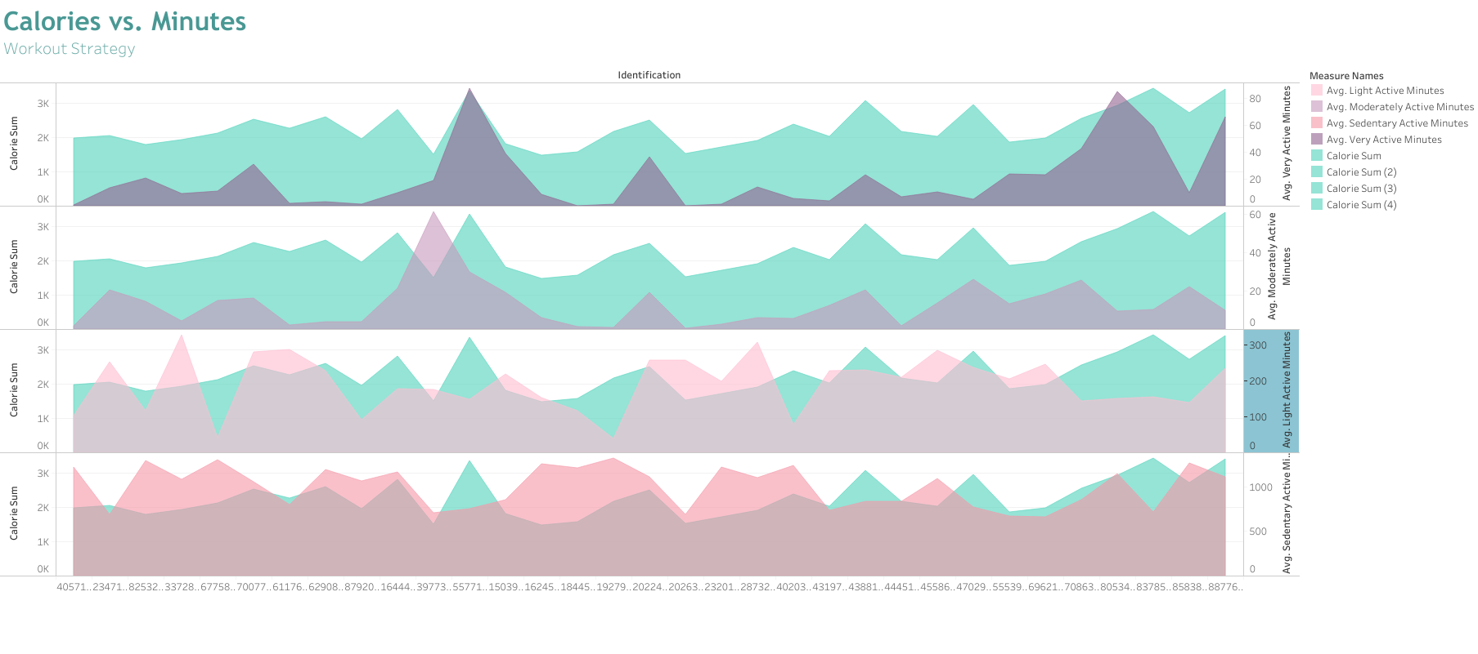

Slide 2
Workout Strategy
File created on: 11/18/2022 8:06:25 PM

Slide 3
